Slide 1
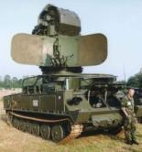

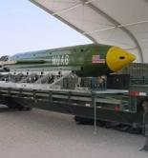
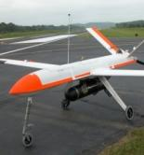
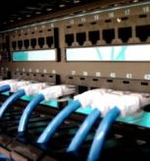
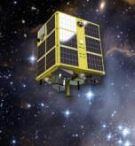

Explorer Post 3.14
autoAuto Project
– 2014 Intro

Slide 2
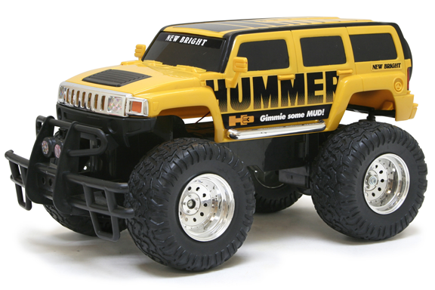
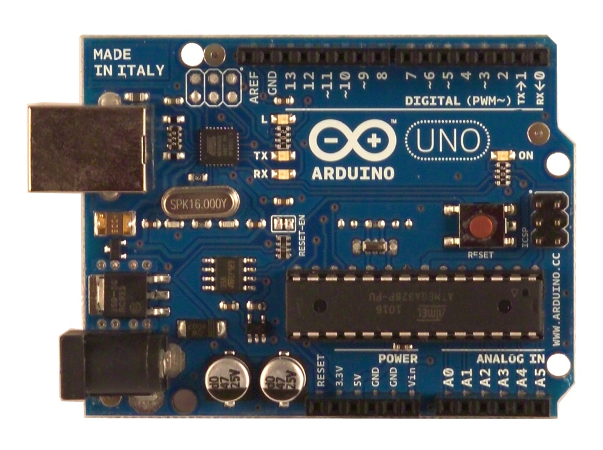
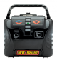

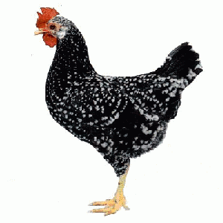
AROBOTS Project – completed concept
Software Modules

Slide 3
AROBOTS Project – motion path concept
Can you end at the SAME place you started?
START

Slide 4
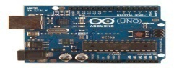

autoAuto – autonomous track-following ground vehicle - Project
Concept
Ground Vehicle includes master control computer and sensor suite
Line sensors detect ground track, provide guidance error information
Obstacle sensor detects obstacle to avoid collision
Ground Vehicle autonomously:
Waits for user command to start
Finds ground track, follows ground track
Detects obstacles before collision and stops
Finds end of track and stops

Slide 5
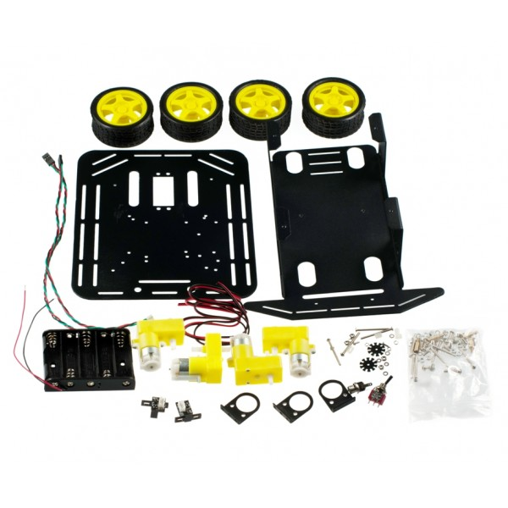
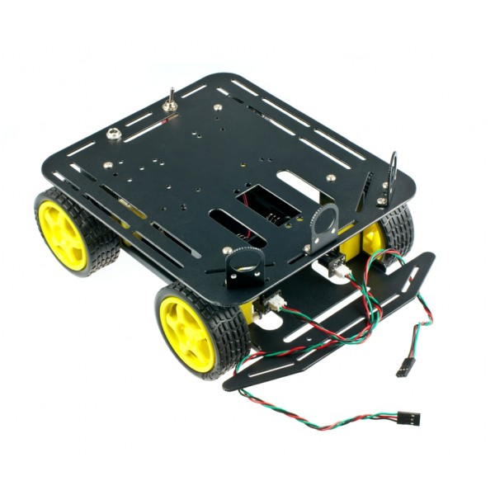
Activities – Mechanical Engineering Vehicle Group
Starting Point – Old RC vehicle
Engineering analysis – vehicle will not support requirements
Starting Point – Select robotics development vehicle
Started with a pile of parts
Mechanical Engineering Tasks
Characterize motor controller
Design drive train, motors, controller use
Assemble vehicle
Wire drive motors and controllers
Mount controller board
Troubleshoot motor operation
Redesign power supply
Mount, wire, and integrate sensors
Mount, wire, and integrate display(s)

Slide 6
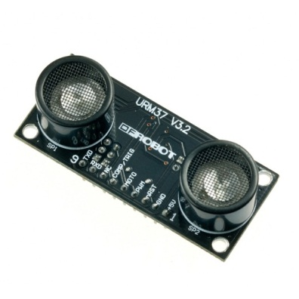
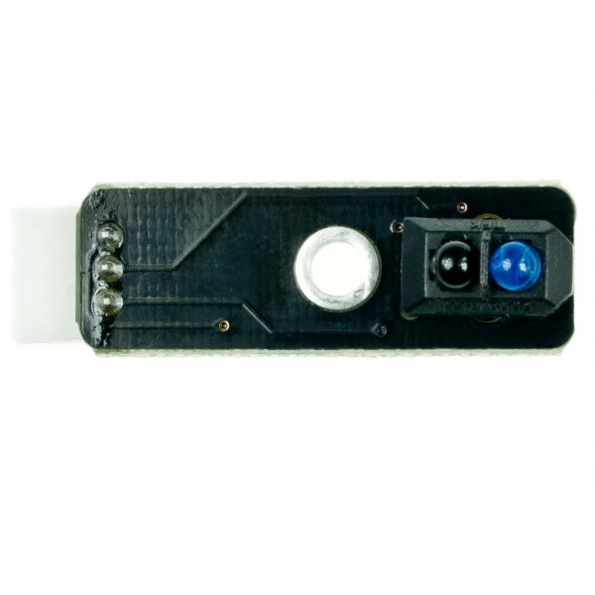
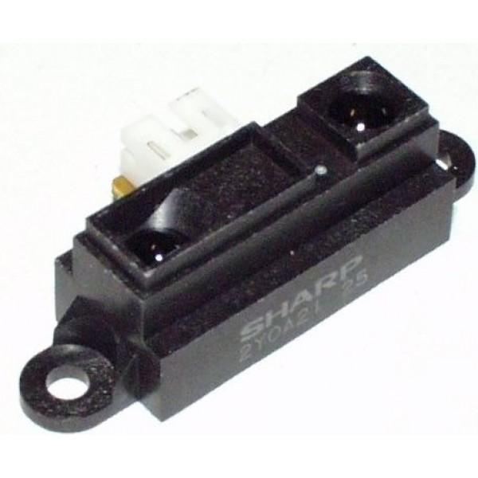
Activities – Electrical Engineering Sensor Group
Starting Point – Select candidate sensor technologies
Range sensor
Line sensor
Electrical Engineering Tasks
Characterize ultrasonic range sensor
Detection ranges
Input signals, output signals
Power requirements
Characterize infrared range sensor
Detection ranges
Input signals, output signals
Power requirements
Characterize line sensor
Detection ranges
Line and background requirements
Input signals, output signals
Power requirements
Suggest mounting requirements

Slide 7
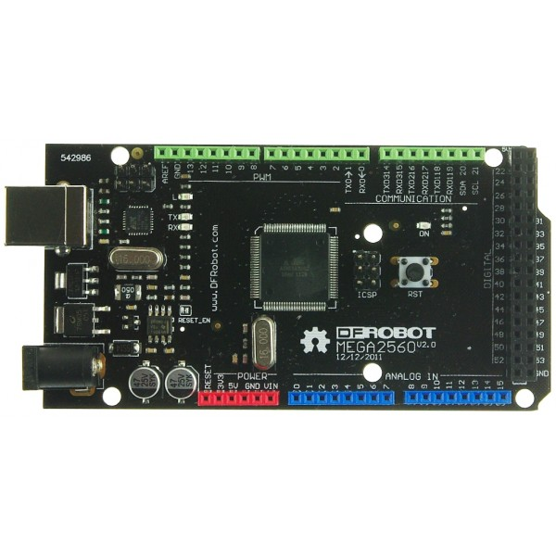
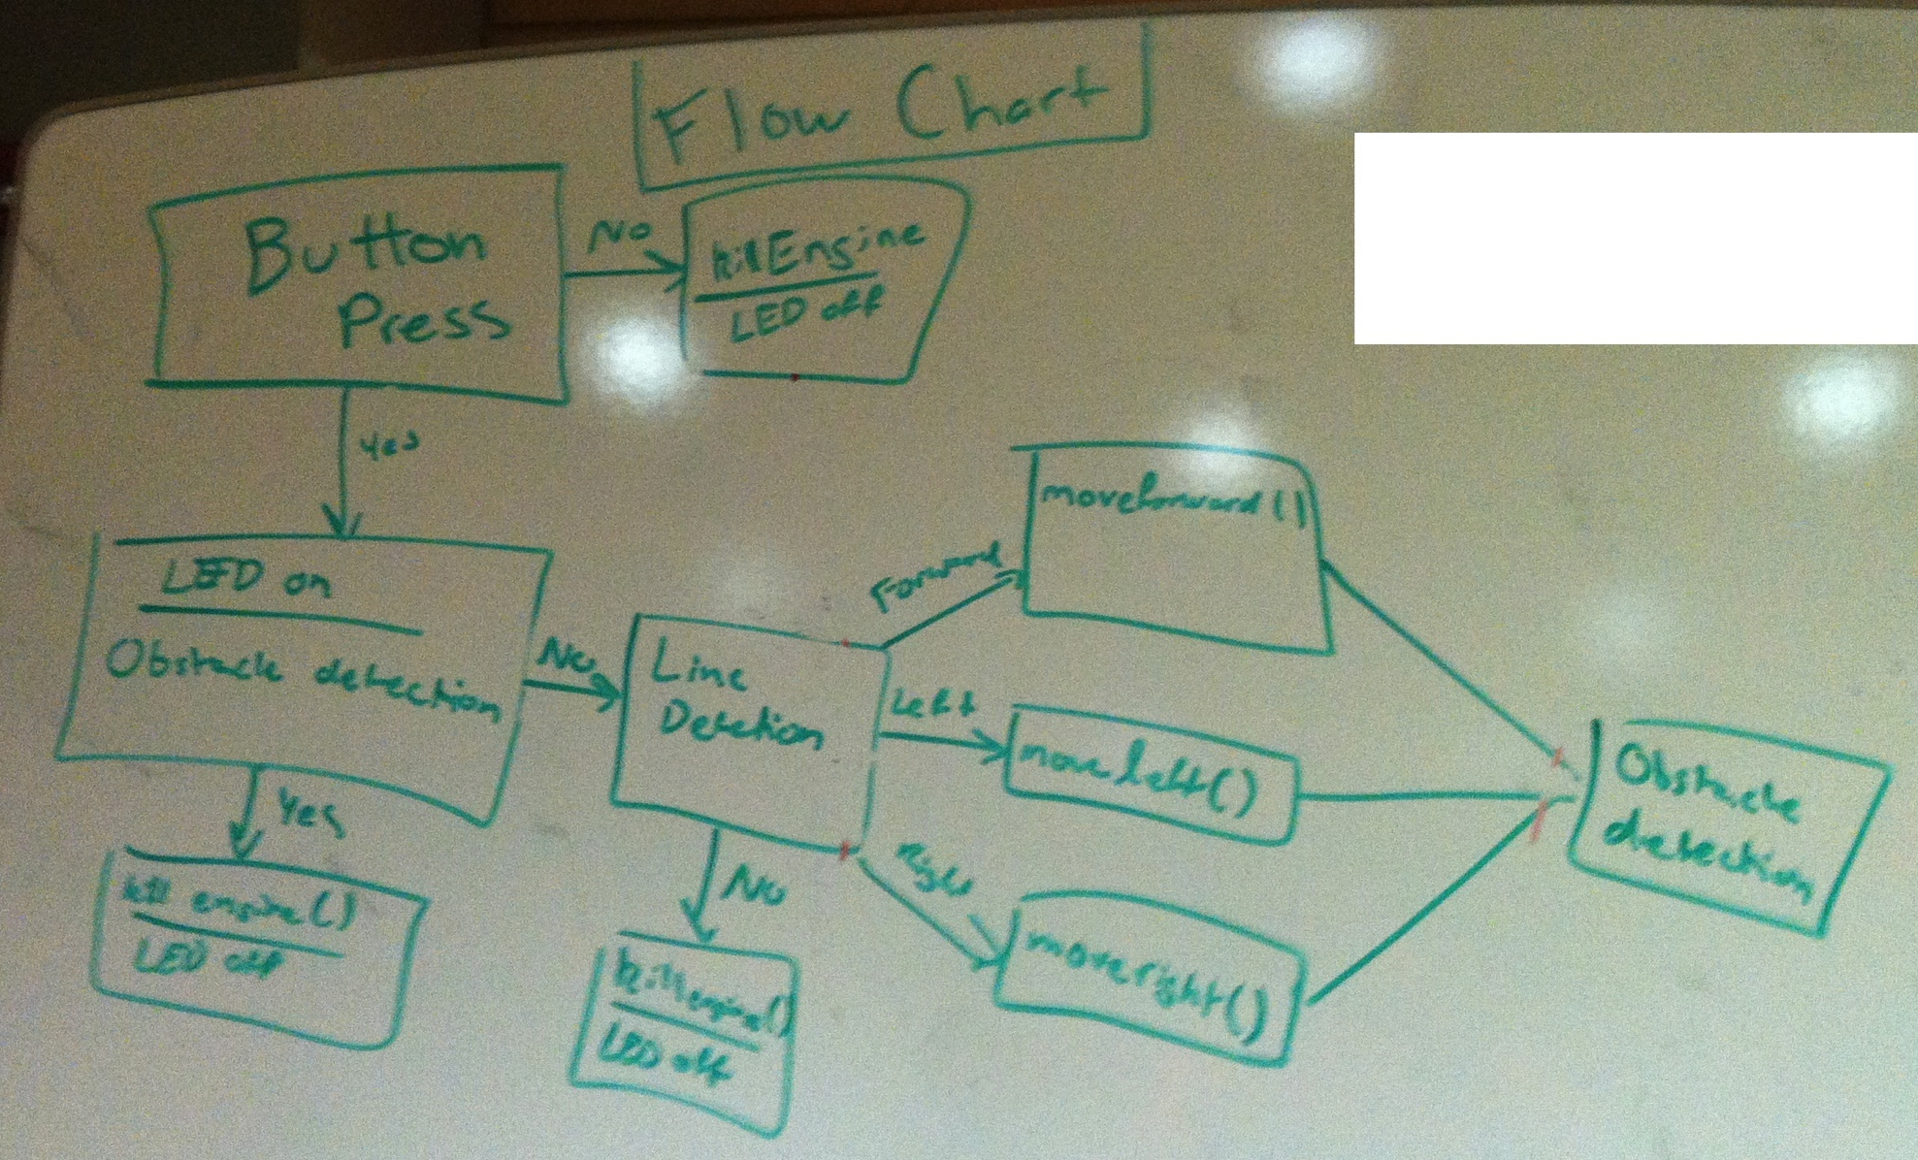
Activities – Software Engineering Software Group
Starting Point – Select arduino uno microcontroller
Engineering analysis – microcontroller will not support requirements
Software Engineering Tasks
Specify more powerful arduino mega microcontroller
Develop top-level software design
Develop detailed software components
Integrate software components
Develop software to support vehicle characterization and integration
Develop software to support system testing
Team Activities
Individuals bring personal laptops to support parallel team efforts
Cross training between team members
Creation of central repository on GitHub

Slide 8
Lessons Learned
Engineering Process
Follow Engineering Process to work through challenging “unknowns”
Documentation
Create and maintain engineering notebooks for each working group
Team Work
Support parallel software development by allowing personal computers
Embed subject matter experts into other working groups
Requirements and Specifications
Initial requirements were incomplete and not well understood
Stand up System Engineering Working Group
Group Dynamics
People come and People go
need to support new members AND maintain progress of project
autoAuto took too long to perform
Improve how we schedule work
Select projects with shorter timelines
Develop interim project phases to increase challenge and fun

Slide 9
Activities – System Engineering Group
Starting Point – Assumed system engineering by management activity
Management did not perform system engineering
Working groups drifted, activities not efficient
System Engineering Tasks
Took ownership of system requirements
Led Technical Requirements Review (TRR) with customer
Discussed customer view of system requirements and typical integration issues
Discussed customer view of desirable use of technology
Conducted requirements analysis
Based on initial concept
Filled in requirements to make consistent and complete
Assign requirements responsibility to working groups
Design test requirements
Assign test requirements to test plan
Develop test range
Execute testing to verify requirements compliance
Study project management concepts

Slide 10
Working on autoAuto
Select a working group (or try them all)
Contribute your expertise and ideas
Learn from your colleagues and advisors
Keep notes and ask questions
Have Fun!
Top Level Schedule
October
Complete assembling vehicle, debugging as required
Complete development of software modules, begin integration
Complete system requirements assignments
Complete test requirements and test schedule
Begin developing test range
November
Complete system integration, debug as necessary
Begin testing, debug and retest as necessary
December
Complete testing. Declare system meets requirements. Deliver to customer.

Slide 11
BACKUP

Slide 12
Project Update
Concerns related to the ability to adequately control the speed and turning of the Hummer vehicle (used on the previous project) prompted us to find another vehicle
Speed appears to be either go full or stop – no intermediate speeds
Turns appear to be either full left or full right – no small turns
Purchased 2 identical vehicle kits:
4WD Mobile Platform
Motor controller & encoders
Microcomputer board
Ultrasonic obstacle sensor
Distance sensor
Bluetooth
Cables
Etc.
Purchased a line-detector sensor recommended by a Dynetics robotics expert
Vehicle platform and sensors can be used on future projects

Slide 13
Inventory of Components Purchased
Digital Sensor Cable For Arduino (10 Pack) FIT0011
LCD Keypad Shield For Arduino DFR0009
Analog Sensor Cable For Arduino (10 Pack) FIT0031
USB Cable A-B for Arduino FIT0056
Baron-4WD Mobile Platform ROB0025
2A Dual Motor Controller DRI0002
DFRobot Bluetooth V3 TEL0026
Bluetooth Adapter Mini TEL0002
Sharp GP2Y0A21 Distance Sensor (10-80cm) SEN0014
Line Tracking Sensor for Arduino SEN0017
DFRobot mega2560 V2.0 (Arduino mega 2560 R2 compatible) DFR0191

Slide 14
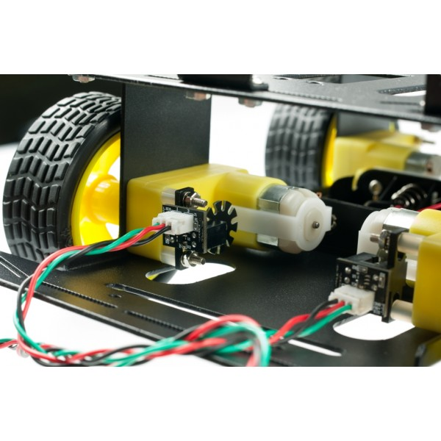
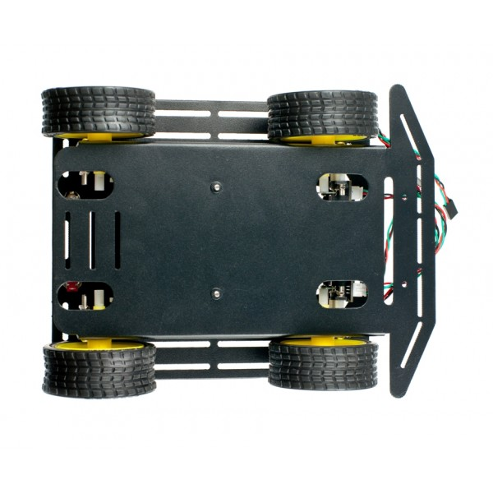
Vehicle
Voltage: +4.5 to 6V
Current: 1200mA load
Motor type: 130
Rotational Speed: 10000 r / min
Gearbox reduction ratio: 1:120
Maximum speed: 68cm / s
Wheel diameter: 65mm
Dimensions: Length 230mm Width 185mm high 110mm
Weight: 614 grams (without batteries)
Maximum load: 800g

Slide 15
autoAuto Project Teams
Project has 4 key development areas to address:
Control of vehicle speed and steering
Line-follow detection
Obstacle detection
Vehicle controller software executive program
Establish 4 teams to individually focus on a key development area
All 4 key development areas will be simultaneously addressed
Any problem areas will be quickly identified, discussed, & a path forward developed
Individuals will gain experience with subsystem/system integration
Individuals will have exposure to multiple technical domains:
Requirements & Specifications Development & Requirements Management
System Integration & Interface Management
Mechanical Design
Electrical Design
Guidance and Control
Software Development
Subsystem & System Test

Slide 16
Team 1- Motor & Steering Control Subsystem
Assemble and inspect vehicles to understand motor and motor driver/encoder characteristics
Review information and vehicle to understand motor connections, encoder operation/output, motor control, and perhaps characterize encoder
Encoder output (pulse rate related to motor speed? Ex: no. of pulses per motor shaft revolution)
Define control/electrical interface of motor and encoder
Develop algorithm to proportionally control motor speed
Use encoder feedback to control motor speed?
Develop performance specification
Develop algorithm interface description
Develop algorithm to implement variable steering (directly affects vehicle guidance algorithm)
How do we (or do we need to) know turn position and/or only straight-ahead (home) position?
Implement left and right turns (desire small turns, not full-limit turns)
Differential wheel turn or single-side wheel turn?
2-wheel or 4-wheel turn?
Develop performance specification and algorithm interface description
Document, and brief post on, the motor speed and steering control performance specifications and algorithm interfaces
B
Encoder
Output
+
-
Speed
Command
A
M

Slide 17
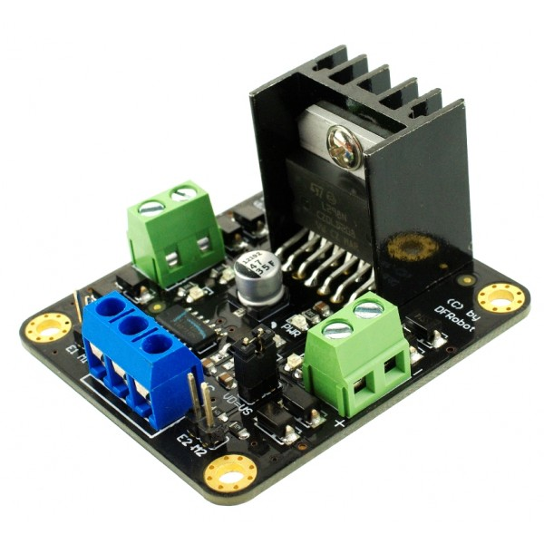
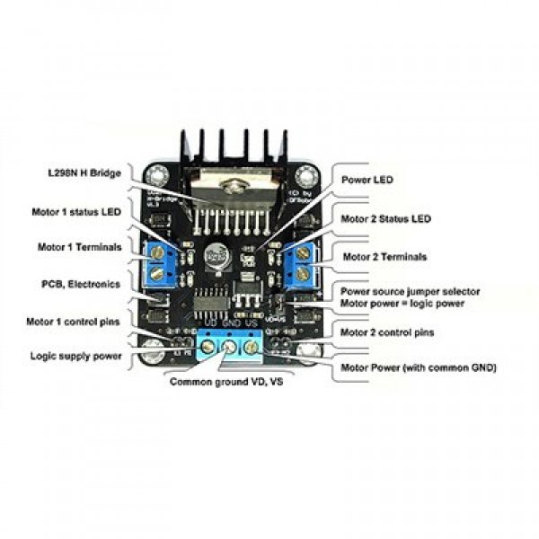

Motor Controller
The logic part of the input voltage: 6 ~ 12V
Driven part of the input voltage Vs: 4.8 ~ 46V
The logical part of the work current Iss: 36mA
Drive part of the operating current Io: 2A
Maximum power dissipation: 25W (T = 75 degree Celsius)
Control signal input level:
High level: 2.3V = Vin = Vss
Low:-0.3V = Vin = 1.5V
Operating temperature: -25 degree Celsius ~ +130 degree Celsius
Drive Type: Dual high-power H-bridge driver
Module Size: 47 mm × 53mm
Module Weight: About 29g

Slide 18
Team 2 – Line-Follower Sensor Subsystem
Review information and evaluate sensor for:
Line contrast/color detection
Minimum/maximum line width
Interference rejection (color sensitivity)
Signal characteristics sent to controller (electrical interface)
Power
Size
Weight
Mounting requirements & location
Develop and conduct tests to characterize sensor performance to define the line track-error output
Left, right, center
Minimum line contrast required
Minimum line width
Minimum line radius of curvature (may be dependent on vehicle speed and/or line width)
Define electrical interface
If sensor is inadequate, identify potential candidate sensors, select one or two to purchase, and characterize performance
Develop algorithm to provide error signal to controller
Left-of-line, right-of-line, centered on-line
Develop performance specification & algorithm interface description
Document, and brief post on, the performance specification and description of algorithm interface

Slide 19
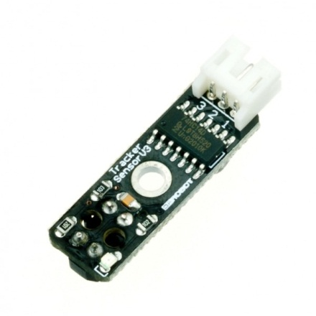
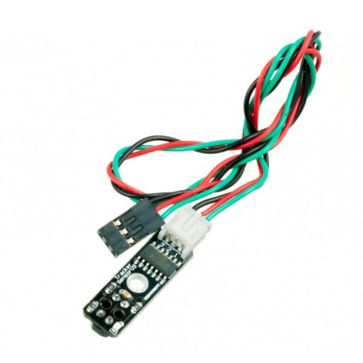
Line Tracking Sensor
This sensor is for line tracking purposes.
It detects white and black color, and it outputs via TTL signal.
Specification
Power supply: +5V
Operating current: <10mA
Operating temperature range: 0°C ~ + 50°C
3-wire output interface
Output: TTL(Black for LOW output, White for HIGH output)

Slide 20
Team 3 –Obstacle Detection Subsystem
Review information and evaluate sensors (ultrasonic and IR) for:
Detection distance
Field of view (in degrees) to minimize false alarms from objects outside of vehicle path
False detections
Signal characteristics sent to controller (electrical interface)
Power
Size
Weight
Mounting requirements
Develop and conduct tests to characterize sensor performance
Field of view
Approximate minimum size of object for reliable detection
Typical detection distance
Sensitivity to objects outside of vehicle path
Define electrical interface
If sensors are inadequate, identify potential candidate sensors, select one or two to purchase, and characterize performance
Investigate potential use of an integrated detection system using both sensors
Potentially use both acoustic (ultrasonic) and IR distance sensor? Use only one of them? – select one
Develop obstacle detection algorithm
Determine signal threshold level for obstacle detection/recognition to minimize false alarms
Rejection of obstacles outside of vehicle path?
Other features………
Develop performance specification & algorithm interface description
Document, and brief post on, the performance specification and description of algorithm interface

Slide 21
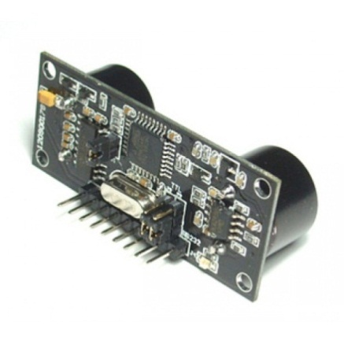
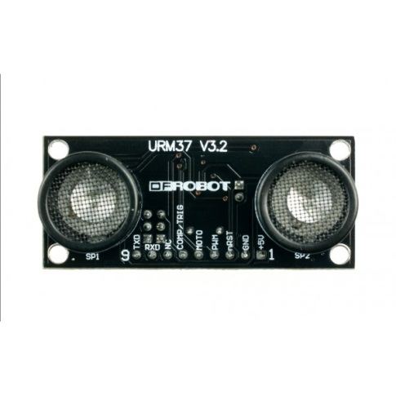
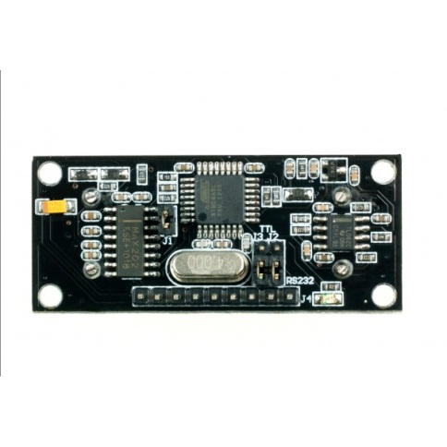
Ultrasonic Sensor
The URM37 V3.2 Ultrasonic Sensor uses an industrial level AVR processor as the main processing unit. It comes with a temperature sensor which is unique in its class. The sensor has unique three output modes (PWM, RS232 or TTL) which allows it easy to adapt to most devices and applications. The sensor provides one channel servo control output which can be used for sweep function. The URM V3.2 Rev2 has a jumper which allows user to select RS232 level output or TTL level output. Specifications:
Power: +5V
Current: <20mA
Working temperature: -10 ~ +70 C
Detecting range: 4cm-3m (3-5m is possible, but depending on situations)
Resolution: 1cm
Interface: PWM, RS232 or TTL (via Jumper)
Servo control: One servo control output
Operating Mode: Serial (PWM) passive control mode; Autonomous Mode; On/OFF Mode
Temperature sensor: 12 bits reading from serial port
Size: 22mm × 51 mm
Weight: 30g

Slide 22
IR Distance Sensor
The Sharp distance sensors are a popular choice for many projects that require accurate distance measurements. This IR sensor is more economical than sonar rangefinders, yet it provides much better performance than other IR alternatives. Interfacing to most microcontrollers is straightforward: the single analog output can be connected to an analog-to-digital converter for taking distance measurements, or the output can be connected to a comparator for threshold detection. The detection range of this version is approximately 10 cm to 80 cm (4" to 32"); a plot of distance versus output voltage is shown below.
Specifications:
operating voltage: 4.5 V to 5.5 V
average current consumption: 30 mA (typical)
distance measuring range: 10 cm to 80 cm (4" to 32")
output type: analog voltage
output voltage differential over distance range: 1.9 V (typical)
response time: 38 ± 10 ms
package size: 29.5×13.0×13.5 mm (1.16×0.5×0.53")
weight: 3.5 g (0.12 oz)

Slide 23
Team 4 – Controller Software Executive Program Subsystem
Integrate algorithms for:
Motor speed and steering control
Line-follower detection
Obstacle detection (ultrasonic and/or distance sensor)
Develop vehicle guidance algorithm using the specifications and interface descriptions developed by the other three teams
Determine how/when to use sensor information
Execute go-forward, go-left, go-right, stop, reverse? commands as required
Determine what to do when an obstacle is detected
Stop, reverse?, etc.
Develop fail-safe watchdog to stop vehicle if something goes wrong or track line ends
Ex: If a line detection (or a change in track-error signal) is not received for a certain period of time, then stop vehicle and indicate a fault
Develop user interface – control and indicators
Go/stop command
Line detection indication
Obstacle detection indication
Fault indication
Other features?
Develop software architecture description
Document, and brief post on, the controller software executive program architecture

Slide 24
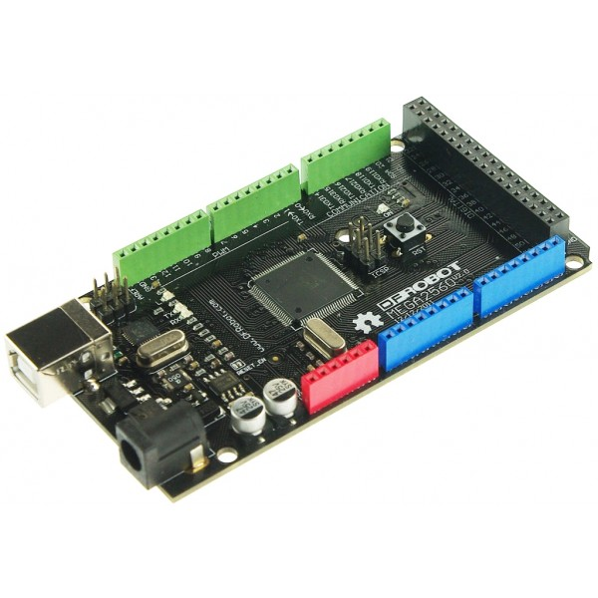
Controller Board
This is the DFRduino Mega 2560 V2.0. It is fully compatible with Arduino Mega 2560 R2. This board features the ATmega8U2 programmed as a USB-to-serial converter and it has a resistor pulling the 8U2 HWB line to ground, making it easier to put into DFU.
Specifications
Compatible with Arduino Mega 2560 R2
Microcontroller: ATmega2560
Operating Voltage: 5V
Input Voltage (recommended): 7-12V
Digital I/O Pins: 54 (of which 14 provide PWM output)
Analog Input Pins: 16
DC Current per I/O Pin: 40 mA
DC Current for 3.3V Pin: 50 mA
Flash Memory: 256 KB of which 8 KB used by bootloader
SRAM: 8 KB
EEPROM: 4 KB
Clock Speed: 16 MHz

Slide 25
System Engineering & Project Management – Executive Committee
Conduct monthly design reviews to:
Evaluate progress
Review subsystem definitions:
Subsystem descriptions and algorithm descriptions and interfaces
Discuss problem areas & develop solutions
Review system performance requirements (operational concept)
Refine product performance requirements (operational concept) as necessary to accommodate issues encountered during product development and integration
Evaluate subsystem performance specifications and algorithm interface descriptions and software architecture:
Motor & Steering Control Subsystem
Line-Follower Sensor Subsystem
Obstacle Detection Subsystem (acoustic and/or distance sensor)
Controller Software Executive Program Subsystem
Develop and conduct tests to prove product meets performance requirements
Note: this committee will comprise 1 member of the 4 teams to implement a Systems Engineering “Executive Committee”

Slide 26
Project Work Breakdown Structure (WBS)
autoAuto Autonomous
Vehicle Product
Motor & Steering Control Subsystem
Line-Follower Sensor Subsystem
Obstacle Detection Subsystem
Software Executive Program Subsystem
System Engineering & Project Mgmt.
Understand motor controller and encoder
Perhaps characterize encoder output
Develop algorithm to proportionally control motor speed
Develop algorithm to implement variable steering
Develop motor speed and steering control performance specifications and algorithm interfaces
Characterize sensor performance to define the line track-error output
Develop algorithm to provide error signal to controller
Develop performance specification & algorithm interface
Characterize acoustic sensor performance
Characterize and investigate use of IR distance sensor
Decide whether to use both sensors integrated or which single sensor to use
Develop obstacle detection algorithm
Develop performance specification & algorithm interface
Develop software architecture
Integrate algorithms
Develop vehicle guidance algorithm
Determine what to do when an obstacle is detected
Develop fail-safe watchdog to stop vehicle if something goes wrong or track line ends
Develop user interface
Conduct monthly reviews and evaluate progress and definitions of each subsystem
Discuss problem areas and develop solutions
Review product performance requirements (operational concept)
Revise product performance requirements (operational concept) as required
Evaluate subsystem performance specifications, algorithms interfaces, and architecture
Develop and conduct tests to prove product meets requirements

